Slide 1
7. Quicksort

Slide 2
7.1 Description of quicksort
Probably the fastest and the most widely used sorting method.
By C. A. R. Hoare in 1960 (a variant is studied here).
Methods:
Divide
Conquer
Combine
An in-place method (uses only a small stack).
A careful implementation is needed.

Slide 3
Pseudocode of quicksort
QUICKSORT(A, p, r)
1 if p < r
2 then q ← PARTITION(A, p, r)
3 QUICKSORT(A, p, q−1)
4 QUICKSORT(A, q+1, r)

Slide 4
Pseudocode of partition
PARTITION(A, p, r)
1 x ← A[r]
2 i ← p − 1
3 for j ← p to r − 1
4 do if A[j] ≤ x
5 then i ← i + 1
6 SWAP(A[i], A[j])
7 SWAP(A[i + 1], A[r])
8 return i + 1

Slide 5
The partitioning process
For the subarray A[p..r], at the beginning of each iteration of the loop in lines 3-6, for any array index k,
1. If p ≤ k ≤ i, then A[k] ≤ x.
2. If i + 1 ≤ k ≤ j −1, then A[k] > x.
3. If k = r, then A[k] = x, the pivot element.

Slide 6
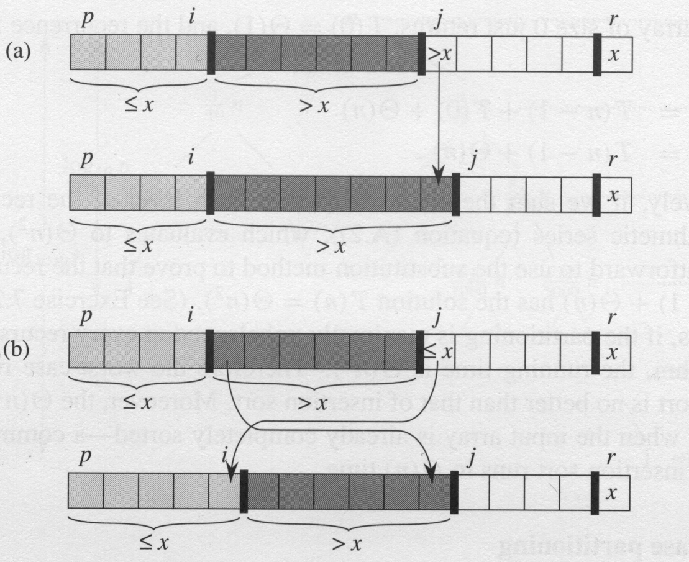
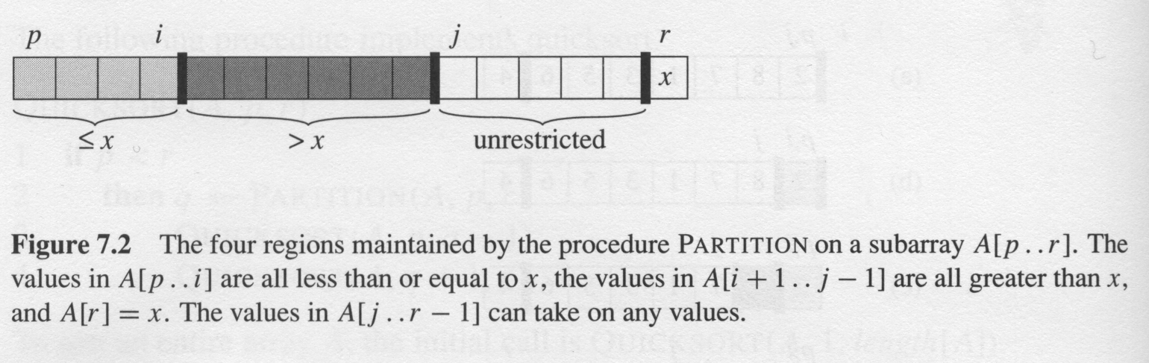
Two cases for one iteration of procedure Partition
Complexity:
Partition on A[p..r] is Θ(n)
where n = r – p +1

Slide 7
The operation of Partition() on a sample array
i
p,j
r
p
i
j
r
(a)
2
8
7
1
3
5
6
4
(f)
2
1
3
8
7
5
6
4
p,i
j
r
p
i
j
r
(b)
(g)
2
8
7
1
3
5
6
4
2
1
3
8
7
5
6
4
p,i
j
r
p
i
r
(c)
2
8
7
1
3
5
6
4
(h)
2
1
3
8
7
5
6
4
p,i
j
r
p
i
r
(d)
2
8
7
1
3
5
6
4
(i)
2
1
3
4
7
5
6
8
p
i
j
r
(e)
2
1
7
8
3
5
6
4

Slide 8
7.2 Performance of quicksort

Slide 9
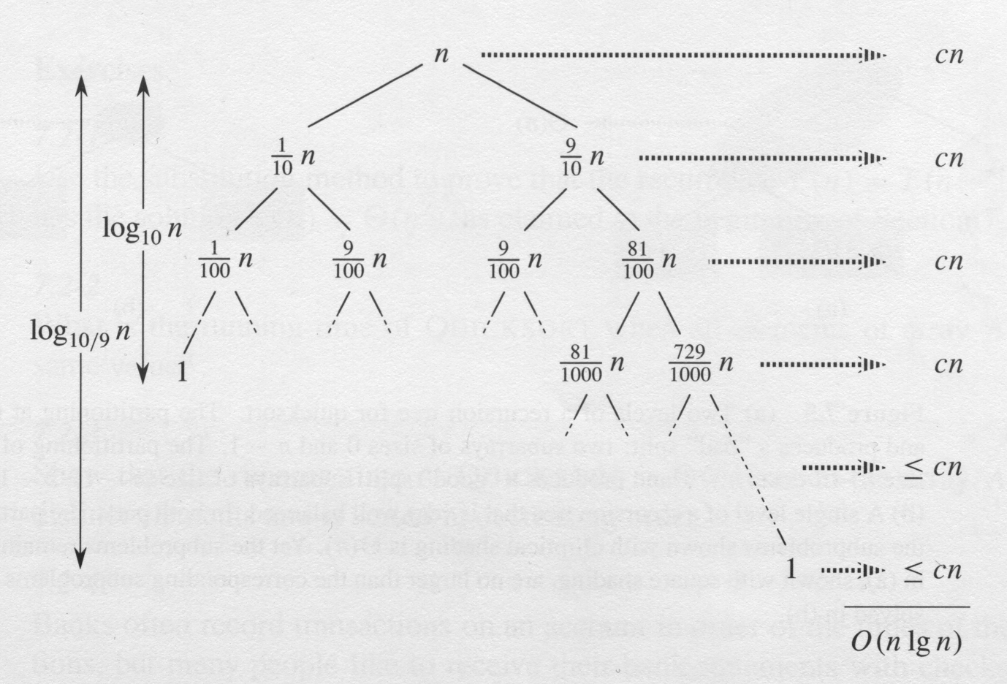

Slide 10
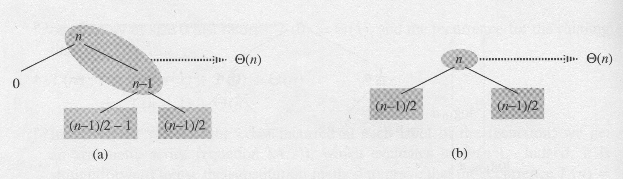
Intuition for the average case T(n) = Θ(n logn)
(a) Two levels of a recursion tree for quicksort. The partitioning at the root costs n and produces a “bad” split: two subarrays of sizes 0 and n – 1. The partitioning of the subarray of size n – 1 costs n – 1 and produces a “good” split: subarrays of size (n – 1)/2 – 1 and (n – 1)/2. (b) A single level of a recursion tree that is very well balanced. In both parts, the partitioning cost for the subproblems shown with elliptical shading is Θ(n)

Slide 11
7.3 Randomized versions of partition

Slide 12
Median-of-3 partitioning method

Slide 13
Improvement on small subfiles
5 ≤ M ≤ 25 (empirically).
20% reduction in the running time.

Slide 14
7.4 Analysis of quicksort

Slide 15
7.4-2

Slide 16
7.4.2 Expected running time
Running time and comparisons
Lemma 7.1
Let X be the number of comparisons performed in line 4 of partition over the entire execution of Quicksort on an n-element array. Then the running rime of Quicksort is O(n+X)

Slide 17
we define
{z_{i} is compared to z_{j}},
{z_{i} is compared to z_{j}}

Slide 18
Pr{z_{i} is compared to z_{j}} = Pr{z_{i} or z_{j} is first pivot chosen from Z_{ij}}
= Pr{z_{i} is first pivot chosen from Z_{ij}}
+ Pr{z_{j} is first pivot chosen from Z_{ij}}

Slide 20
another analysis

